Slide 1

Market Risk
Basics
Eugene Kirimov
BODIAN LI

Slide 2


Market Risk
What is Market Risk?
Monitoring and Measuring Market Risk

Slide 3


Market Risk
Definitions

Slide 4
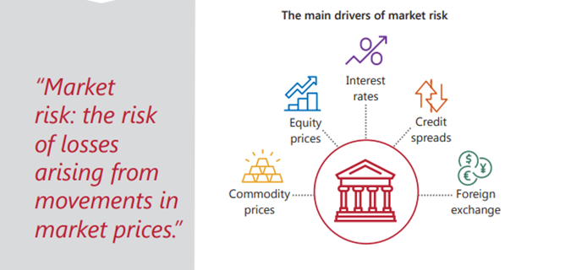
What is Market Risk?

Slide 5
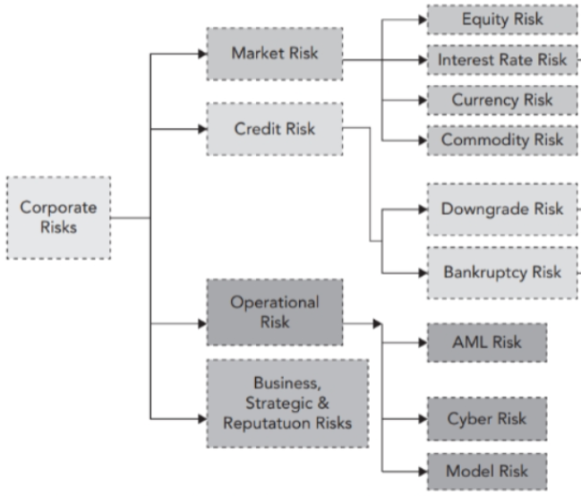
What is Market Risk?
We split Market Risk into these four categories :
Interest Rate Risk
Equity Price Risk
Foreign Exchange Risk
Commodity Price Risk

Slide 6
What is Market Risk?
Federal Reserve Board - Market risk is rated based upon these factors:
The sensitivity of the financial institution's earnings or the economic value of its capital to adverse changes in interest rates, foreign exchanges rates, commodity prices, or equity prices.
The ability of management to identify, measure, monitor, and control exposure to market risk given the institution's size, complexity, and risk profile.
The nature and complexity of interest rate risk exposure arising from nontrading positions.
Where appropriate, the nature and complexity of market risk exposure arising from trading and foreign operations.

Slide 7

Market Risk :
Interest Rate Risk
Equity Price Risk
Foreign Exchange Risk
Commodity Price Risk

Slide 8
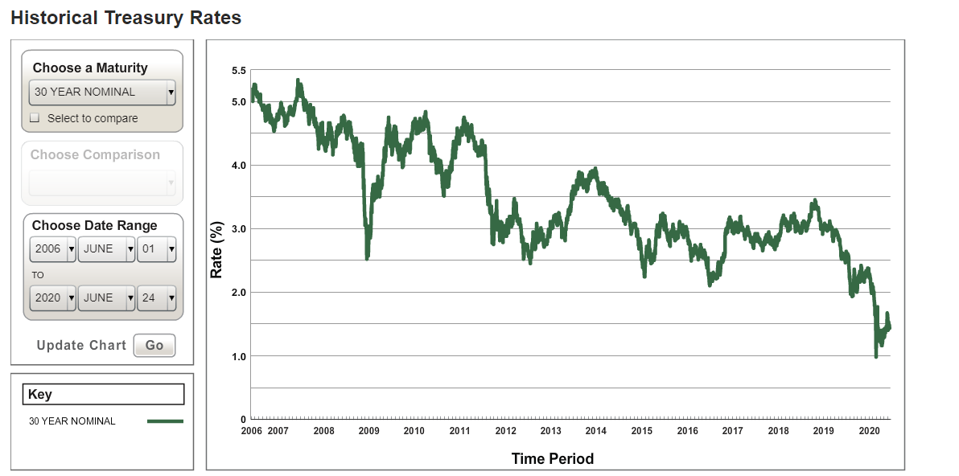
Interest Rate Risk
Banks provide loans to customers, funding these loans with deposits, interbank borrowing, debt issuance, and capital.
The market risk that most banks run is the nontraded kind, also called interest-rate risk in the banking book (IRRBB), as opposed to the trading book.
“Principle 1: IRRBB is an important risk for all banks that must be specifically identified, measured, monitored and controlled. Banks also have market risk from foreign exchange, commodities, and equities, depending on the scale of their global operations and trading businesses.”
Principles for banks and supervisors on interest rate risk
-Basel Framework
Interest Rate Risk is more difficult to manage than the risks arising from market variables such as equity prices, exchange rates, and commodity prices.
Reasons are many rates ( SOFR, LIBOR, Treasury) as well as many maturities, ranging from overnight to 30 years. Different accounts/financial instruments will behave differently to movements in different curves as well as different parts of the curve.

Slide 9
Interest Rate Risk
Interest Rate Risk in the Banking Book
Interest rate risk is a bank’s exposure to adverse movements in interest rates. Interest rate risk in the banking book (IRRBB) more specifically refers to the current or prospective risk to the bank’s capital and earnings arising from adverse movements in interest rates that affect the institution’s banking book positions.
When interest rates change, the present value and timing of future cash flows change. This in turn changes the underlying value of a bank’s assets, liabilities and off-balance sheet instruments and hence its economic value (EV).
Changes in interest rates also affect a bank’s earnings by altering interest sensitive income and expenses, affecting its net interest income (NII). This risk is inherent to the banking business and its successful management can have an important impact on profitability and shareholder value. Indeed, excessive interest rate risk can pose a significant threat to a bank’s current capital base and/or future earnings if not managed appropriately
-Basel Framework

Slide 10
Interest Rate Risk
Forms of Interest Rate Risk
Gap Risk – assets (loans) don’t match with liabilities in terms of tenor (time), duration (sensitivity to changes in rates)
Optionality Risk – prepayment for mortgages for example can lead to potential mismatches and can affect profitability – account for this with prepayment models
Basis Risk – assets and liabilities can be linked to different rates for example T-bills on one side, and LIBOR or SOFR on the other. There are some inherent differences, such as reset date, that may create risk exposure.
Yield Curve Risk – One part of the yield curve may change without having a substantial impact on different parts of the curve.

Slide 11
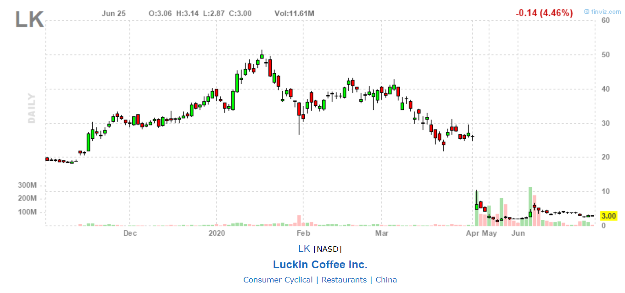
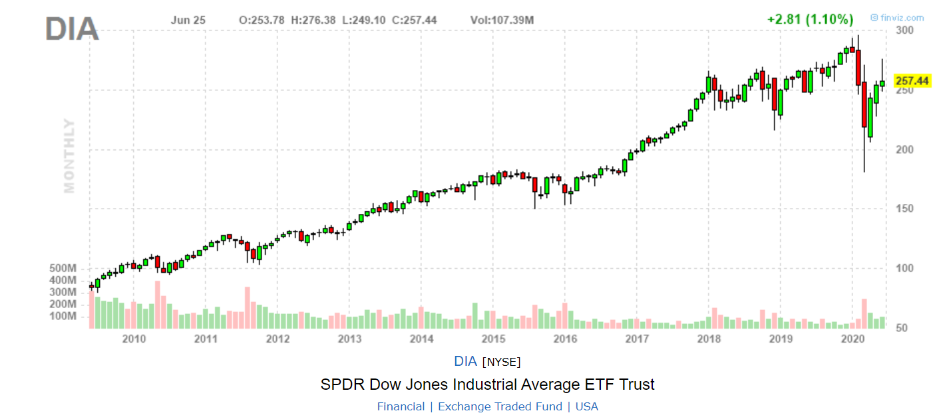
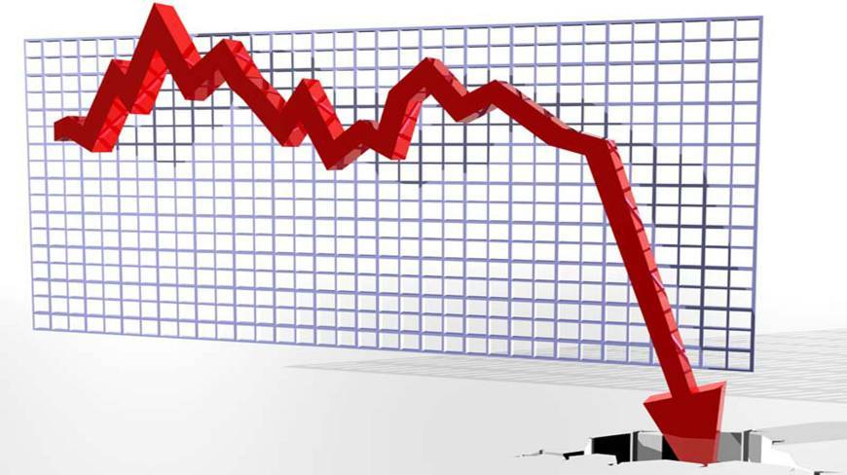
Equity Risk
Definition
Refers to the volatility of stock prices
General market risk – sensitivity of the price of a stock to changes in broad market indices
Specific risk - of a stock due to unique factors
(line of business, strategic weaknesses, new competition..)

Slide 12

Foreign Exchange Risk
Definition
Refers to the losses that an international financial transaction may incur due to currency fluctuations
Foreign exchange risk arises from imperfect correlations in currency price movements as well as changes in int’l interest rates
Inherently present when a company engages in financial transactions denominated in a currency other than the currency where that company is based (Imports and Exports, International Banking)

Slide 13

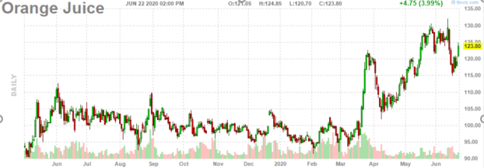
Commodity Price Risk
Definition
Refers to price volatility of commodities (precious metals, base metals, agricultural products, energy) due to the concentration of specific commodities in the hands of relatively few market participants (oil OPEC cuts)

Slide 14
Market Risk
Tools used to control/hedge Market Risk:
Options – a premium paid for the right but not the obligation to buy/sell an asset at an exercise price determined today, before an expiration date in the future. Can be used as insurance to limit losses, or hedge positions.
Swaps – an interest rate swap is an agreement between two parties to exchange interest payments based on a specified principal over a period of time. Ex. Fixed vs. floating is a plain vanilla swap. A currency swap exchanges interest rate payments in two different currencies.
Futures Contracts - formalized, legally binding agreement to buy/sell a commodity/financial instrument in a pre designated month in the future, at a price agreed upon today by the buyer and seller. Producers of grains or any commodity, for example can use these to lock in prices for their crops. Futures contracts exist for a different markets, interest rates, indexes, as well as commodities.
Forward Contracts – contract that specifies the price and quantity of an asset to be delivered sometime in the future (Forex, commodities)
These are all more related to the Trading Book, as opposed to the Banking Book which we mostly deal with here. The trading book contains securities that are “marked to market” or repriced daily. The projects we do with Market Risk are more concerned with IRRBB.

Slide 15
Monitoring
and Measuring

Slide 16
Metrics
Basel Accords give guidance on required disclosures which include metrics and measurements. Common disclosure requirements include change in Economic Value of Equity (∆EVE) and change in Net Interest Income (∆NII) based on prescribed interest rate shock scenarios.
Gap – Traditional measure of risk representing the outstanding risk position per time bucket
NII – The main part of total earnings (interest income)
EVE – economic value ( calculates present value of all expected cash flows )
Stress Tests – Regulators use specific stressed scenarios every year to test a banks resiliency to economic downturns
“The Fed tested banks on their ability to weather two hypothetical scenarios — a baseline of typical economic conditions and a “severely adverse scenario” — and three coronavirus-specific situations: a V-shaped recession and recovery; a slower, U-shaped recession and recovery; and a W-shaped, double-dip recession. Fed said several banks came close to the minimum levels of cash reserves mandated by Dodd-Frank.”

Slide 17
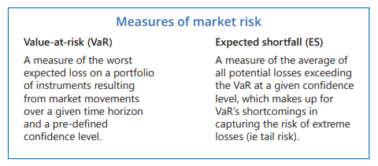
Measurements
Value at risk (VaR) is a measure of the risk of loss for investments. It estimates how much a set of investments might lose (with a given probability), given normal market conditions, in a set time period such as a day or a year
VaR is typically used by firms and regulators in the financial industry to gauge the amount of assets needed to cover possible losses.
Expected Shortfall – takes the worst cases outside of the VaR at a given confidence level, so all those that are more than $25 million and find the average.
Important for the bank to know these what losses can be expected as well as unexpected in the more extreme tail scenarios

Slide 18
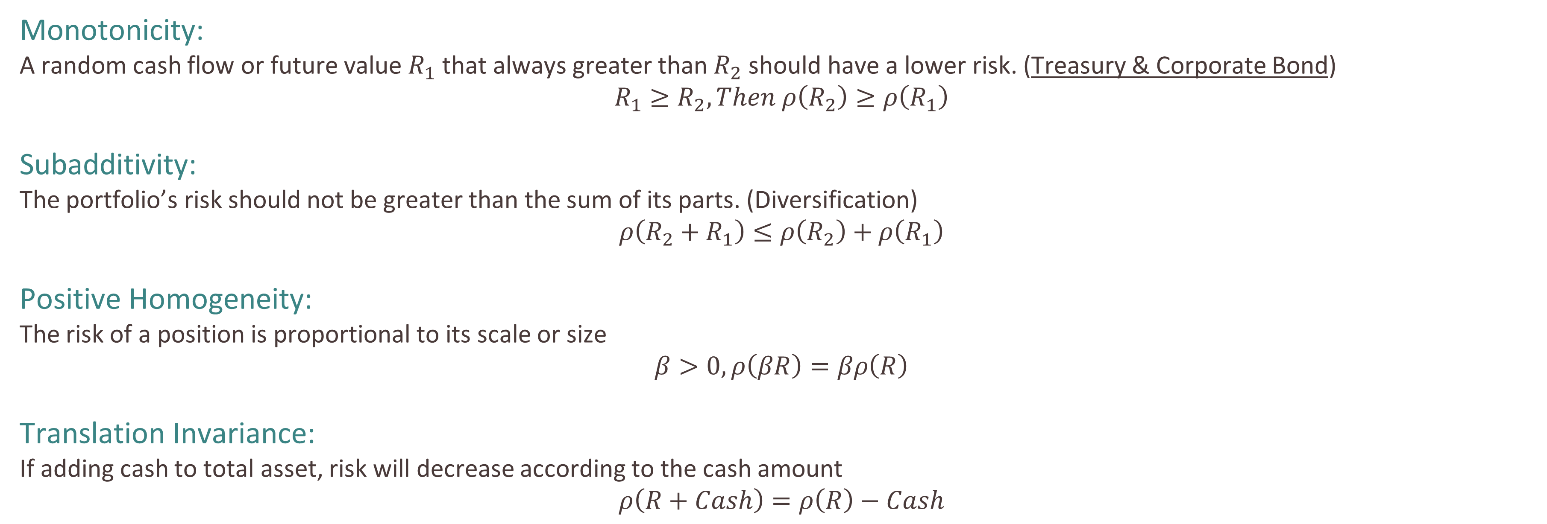
What is a good measurement?
Monotonicity:
A random cash flow or future value $R_{1}$ that always greater than $R_{2}$ should have a lower risk. (Treasury & Corporate Bond)
$$R_{1}≥R_{2}, Then ρ\left(R_{2}\right)≥ρ\left(R_{1}\right)$$
Subadditivity:
The portfolio’s risk should not be greater than the sum of its parts. (Diversification)
$$ρ\left(R_{2}+R_{1}\right)≤ρ\left(R_{2}\right)+ρ\left(R_{1}\right)$$
Positive Homogeneity:
The risk of a position is proportional to its scale or size
$$β>0, ρ\left(βR\right)=βρ\left(R\right)$$
Translation Invariance:
If adding cash to total asset, risk will decrease according to the cash amount
$$ρ\left(R+Cash\right)=ρ\left(R\right)−Cash$$

Slide 19
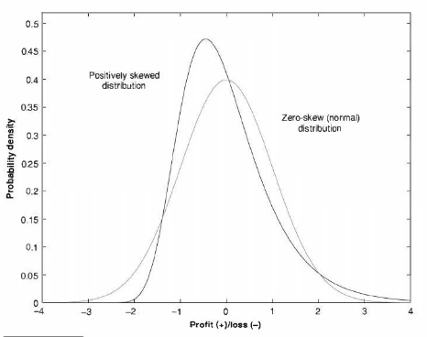
Method 1: Mean-Variance Framework (Parametric Method)
We model financial risk in terms of the mean and variance (or standard deviation) of P/L (or returns). We assume the daily P/L or returns obey a normal distribution.
Normally, distribution is right skewed and has heavier tails, so there is highly possible happen extreme loss. Therefore, normality assumption is inappropriate and mean-variance framework can produce misleading estimates of risk.
Not Good

Slide 20
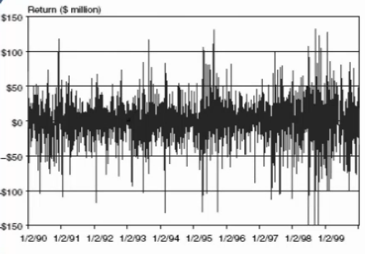
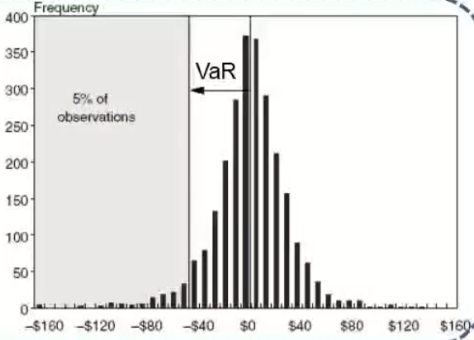


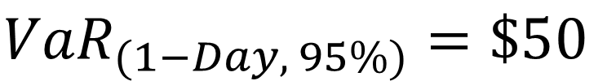

Method 2: Value at Risk (Parametric Method)
Definition:
Maximum Loss over a Target Horizon and for a given Confidence Level.
Example: Confidence Level: 95% ,
Holding Horizon: 1-Day,
Maximum Loss: $50
$${VaR}_{(1−Day, 95\%)}=\$50$$
Interpretation:
1. One day 5% VaR is $50. There is an 5% chance that on any given day, the loss of my portfolio will be greater than $50.
2. On a given day, there is a 95% change the loss of my portfolio is less than $50
P(Loss <= $50 | 1-day) = 95%
3. In 100 days, I can expect 5 days with losses of greater than $50 in my portfolio

Slide 21
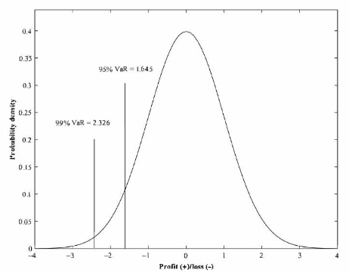

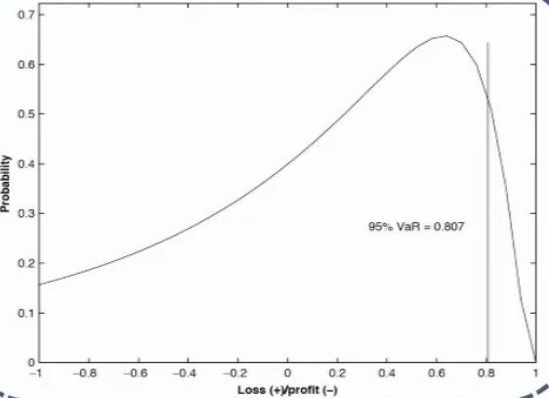
Method 2: Value at Risk (Parametric Method)
Using parameter to calculate VaR:
Mean(u), STDEV(ơ)
We assume that returns obey Normal Distribution with mean(u) and standard deviation(ơ)
Or, we assume that returns obey Lognormal Distribution

Slide 22
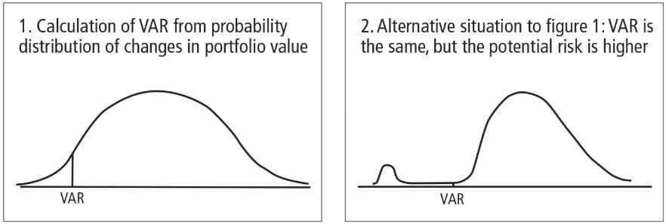

Method 2: Value at Risk (Parametric Method)
Limitation:
If tail event occurs, we can expect to lose more than VaR, but VaR can’t tell us “how much that might be”
VaR may not comply sub-additive. We have different way to estimate VaR, Parametric and Non-Parametric.
In Parametric method, VaR can follow subadditivity because we have assume VaR follow normal distribution.
In Non-Parametric method, VaR violate subadditivity.
$${σ_{p}}^{2}={{(w_{2}σ}_{2})}^{2}+{{(w_{1}σ}_{1})}^{2}+{2{ρw}_{1}σ}_{1}{w_{2}σ}_{2}$$
$$σ_{p}≤{w_{2}σ}_{2}+{w_{1}σ}_{1}$$

Slide 23
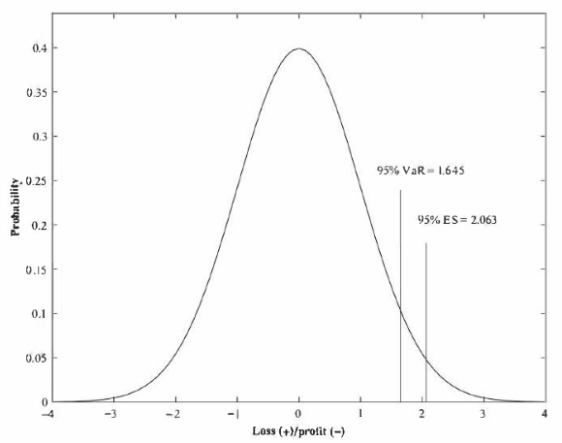
Method 3: Expected Shortfall (Parametric Method)
Definition:
The expected value of loss when it exceeds VaR
Measures the average of loss conditional on the fact that it is greater than VaR
ES indicates the potential loss if the portfolio is “hit” beyond VaR
ES is an average of the tail loss
Can’t Replace VaR
Example:
Given the following 30 ordered percentage returns of an asset:
-16, -14, -10, -7, -7, -5, -4, -4, -3, -1, -1, 0, 0, 1, 2, 2, 4, 6, 7, 8, 9, 11, 12, 12, 14, 18, 21, 23
90% VaR is: $10
90% ES is: $15

Slide 24
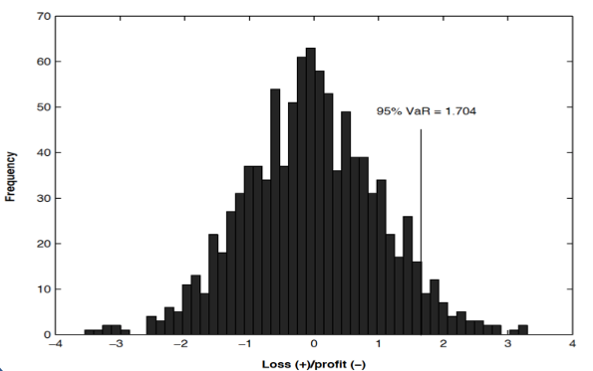
Method 4: Historical Simulation (Non-Parametric Method)
All non-parametric approaches are based on the underlying assumption that The near future will be sufficiently like recent past
Descending without taking consideration of time
Bootstrap:
Create a large number of new samples
Each observation was drawn at random from original sample
Replace the observation after it has been drawn
Repeat….
Calculate Average VaR of different samples.
Example:
I have 1,000 data and want to find 95% VaR
Bootstrap:
Randomly select 100 data as Sample_1 and calculate 95% VaR of this Sample_1 as VaR_1
Replace and resample 100 data as Sample_2 and calculate 95% VaR of this Sample_2 as VaR_2
……
Calculate Average of (VaR_1, VaR_2, VaR_3……) as VaR
More Accurate!
But… Time Series(X)

Slide 25
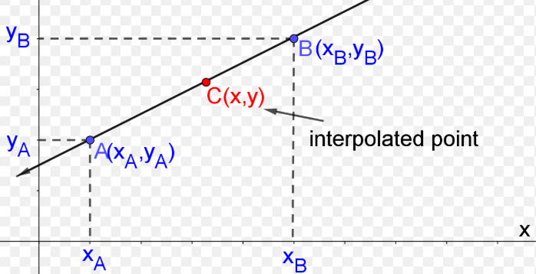
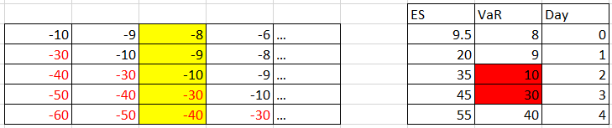









Method 4: Historical Simulation (Non-Parametric Method)
Drawbacks:
Historical Simulation only allow us to estimate VaR at discrete confidence interval. (95%, 96%, 97%...)
For instance: the VaR at 95.1%, 95.2%.... There is no corresponding loss observation.
Solve: Interpolation
Ghost Effect
Appearance:
One return observation will affect each of the next n observations in P/L Series.
But after n periods have passed, observation will fall out of the dataset
Essence:
New Data should have heavier weighted in calculation
$$t_{−100}$$
$$t_{−99}$$
$$t_{−98}$$
$$t_{0}$$
$$t_{1}$$
$$t_{2}$$
$${VaR}_{0}$$
$${VaR}_{1}$$
$${VaR}_{2}$$

Slide 26
A/D of Non-parametric Methods
Advantage
Intuitive and simple
Do not depend on parametric assumptions
Accommodate any type of position: Stock, Future, Option
Use data directly
Disadvantage
Very Dependent on historical data
Subject to ghost effect
If data was usually quiet without huge volatility, VaR and ES will be smooth
Have difficulty to handle extreme value:
Underestimate risk: extreme event didn’t happen in window doesn’t mean it will not happen in future
Overestimate risk: most of extreme event are unlikely to recur

Slide 27
Measurements
The PnL project shows the profit and loss, or the changes in NII and MVE (market value of equity) due to the effect of 520 historical rate shock scenarios. We used NII and MVE sensitivities ( how much the value changes in relation to a small change in rates ) to calculate the total effect on interest income (NII) and economic value (MVE) for each scenario, and broke the metric down by reporting entity, business line, and accounting classification.

Slide 28


Be Aware of Risk

Slide 29
Basel Framework
https://www.federalreserve.gov/supervisionreg/topics/market_risk_mgmt.htm#:~:text=The%20ability%20of%20management%20to,exposure%20arising%20from%20nontrading%20positions.
https://www.treasury.gov/resource-center/data-chart-center/interest-rates/Pages/Historic-LongTerm-Rate-Data-Visualization.aspx
https://www.bis.org/bcbs/publ/d457_inbrief.pdf
Risk Management and Financial Institutions, by John Hull, John Wiley & Sons, Inc., 2018, pp. 175–299.
“Chapter 13: Market Risk and Non-Traded Market Risk.” The Moorad Choudhry Anthology: Past, Present and Future Principles of Banking and Finance, by Moorad Choudhry, Wiley, 2018.
References

